Slide 1
Become a kickstarter
now!!!!!
Notes:
Are you an entrepreneur or a creative?
Do you dream BIG And do you need money to fund your project?
Then you need crowdfunding!
Crowd funding gets bored internet users from around the world to give you money.
And the best crowd funding platform is Kickstarter!

Slide 2
Is your project a success?
!!!Spoiler Alert!!!
With us,
IT IS!!
Notes:
So we have convinced you to launch your project on Kickstarter? But Kickstarter is a ‘All or nothing’ platform.
Meaning if you meet your goal you get all the pledged money, if you don’t reached your goal you get NOTHING!
Nobody likes wasting time with failure. So the important question is - Is your kickstarter project a success?
(on click) Spoiler alert! With us it is a succes.

Slide 3

Hello!
Bam!
We are the Kickstarter Rockstars and we are here to kick it up a level
Notes:
So who are we?
We are Max and Maxima.
And we are here to tell you, based on our unbeatable machine learning algorithm, if your project will be a success .
Why should you trust us?
Because we have 6-weeks experience building complex data science models. And have the best copy pasting skills in the business

Slide 4

Tired of looking in the mirror and seeing FAILURE?
Notes:
In order to be a success, you need to know what success looks like, and what failure looks like! But maybe you already have experience with that! We end this now!

Slide 5
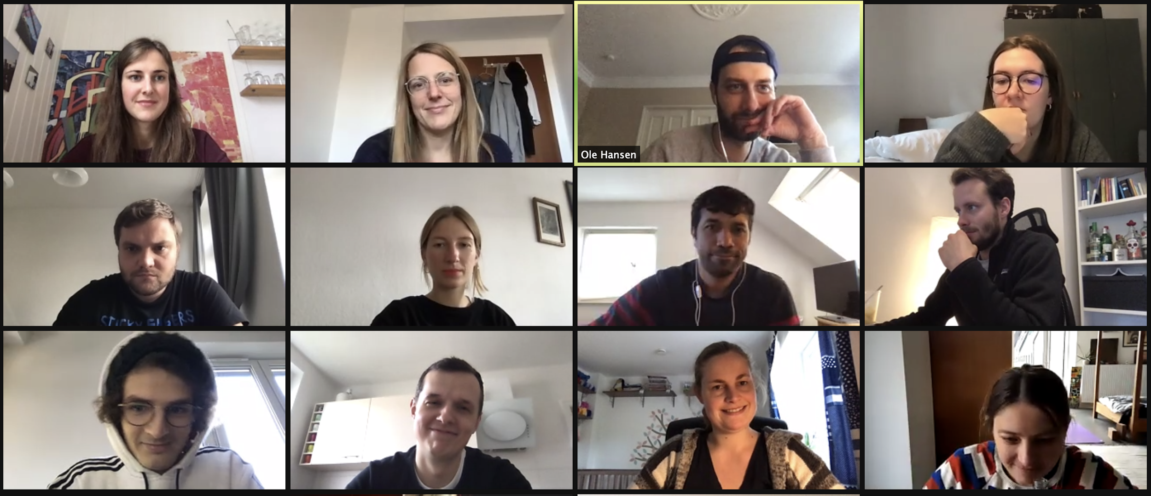
What do you see?
$ 123 pledged
FAILure
185 backers
10% of goal
😭
😭
On average
😭
Next time ask your mom
😭
😭
Total failure!
Notes:
So what do you see?
42 % of all crowdfunding projects fail - so five of you will fail!
-Petra? Tell us about your project? BORING! I am already looking for cat videos!
-Tereza
-Chandra
-Andreas
-Martina
So make your campaign a success and come to the 57% of winners!
Maxima will tell you more!

Slide 6
Failure Looks like:
$ 1600 pledged
19 backers(On average)
1% of goal Reached (Median)
On average
Did you even ask your mom?
Median of failure = Total failure
Notes:
This how failure looks like!
-Failures pledged for 1600 USD on average - but all of them get nothing, because they set their goal too high!
-The average failure only has 19 backers - that is as good as nothing!
-Half of all failures only get pledges equal to 1% of their goal.
Dont end up here! Be a winner!

Slide 7
Success Looks like:
$ 19,200 pledged
220 backers (On average)
119% of goal reached(Median)
On average
How many friends do YOU have?
Overachieving Success!
Notes:
And this is what you can expect if you are a winner:
-Average winners get 19,200 USD and have 220 backers!
-Moreover, half of them reaches more than 100 % of the goal.
This is awesome, right! Become awesome with us!

Slide 8
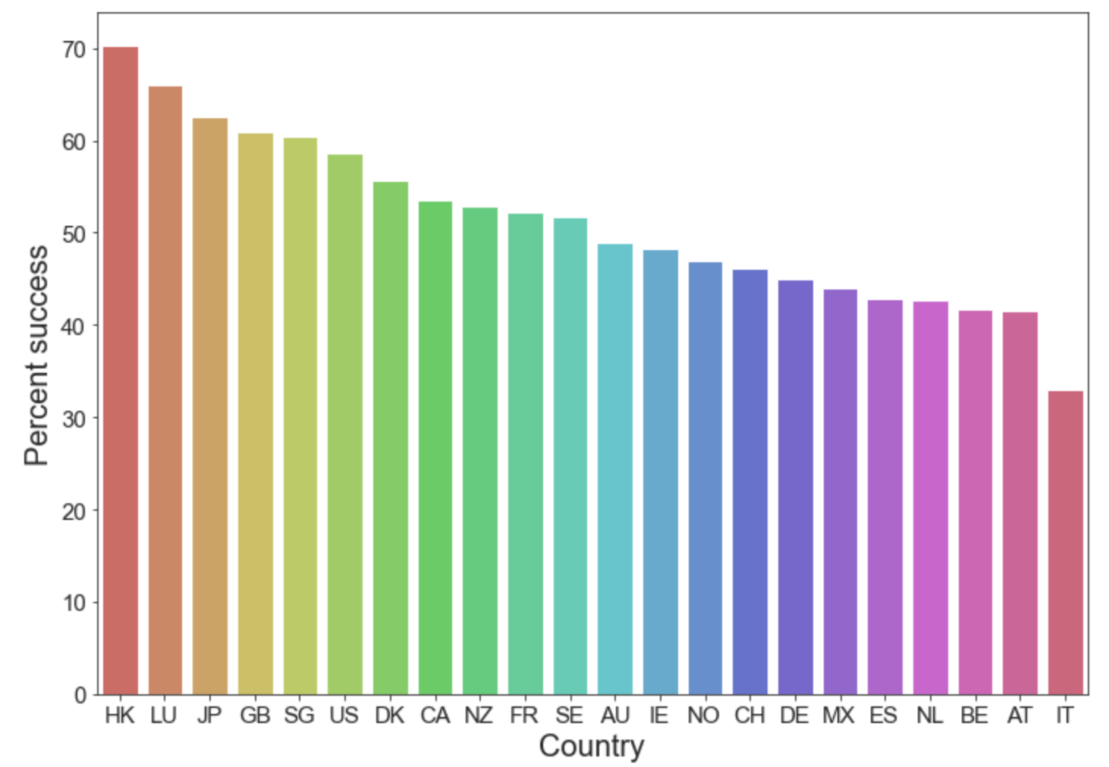
Where in the world??
Notes:
Be smart! And launch your project in Hongkong, Luxemburg or Japan! The top places to launch crowdfinding campaigns. And stay away from Italy, Austria and Belgium to raise your chances!

Slide 9
Let’s cut the chalk from the cheese
 | Goal | Blurb Length | Project Duration | Modal Category
Failure | 6000 | 124 | 34 | Technology
Success | 3500 | 123 | 30 | Music
*Medians
Notes:
So our very general advice is...
* #### Don't ask too much money and set your USD goal realistically around 3500 USD.
* #### Make a detailed (and precise) description of your project.
* #### Set sufficient time (project duration) to reach your USD goal - around 30 days would be great.
* #### There is no 'one best project category'. Take courage - Any project category can be successful!
AND LASTLY: Get as many backers as possible (Strongly advertise your compaign on social media)!
This is very general advices, but there is a lot to think of!
You need our expertise to turn your specific project into a success!
Let us predict the success of your project with our machine learning model.

Slide 10
Our model is
ada-BOOSTED
Notes:
Our model uses the Ada-Boost Algorithm - to precisely predict success or failure of your project! And this is how it works...

Slide 11
Our process is easy
Build Model
Predict Success
Add
Data
Notes:
Data:
We looked at Over 200 Thousand past projects to build our machine learning model.
Just give us some information:
Your Goal / Your project duration / Your project description / Category / Country
We plug it into our model and get a prognosis for your project.

Slide 12
0.81325272
Whoa! That’s a high accuracy score*, aren’t you impressed?
*F-beta score at beta = 0.5
Notes:
We are trustworthy. Our algorithm never lies.
Our model is optimised to be precise, we won’t let you launch a failure .
Just look at our accuracy score - over 80% predicted correctly.

Slide 13
Convinced!
👍
Back our kickstarter project here:
https://www.kickstarter.com/max_predictions
Notes:
To recap: close to half of all projects fail but with us you can be 80% sure of our predictions
Are you conviced to be a success? Just back our kickstarter project here: …

